Slide 1

Organizational Behavior
(MGT-502)
Lecture-34

Slide 2
Summary of
Lecture-33

Slide 3
Human Resource Policies and Practices

Slide 4

HRM Activities
Getting people
Preparing people
Stimulating people
Keeping people

Slide 5

Managing Human Resources for This Era
Organizational ability
To Attract
To Develop
To Motivate and
To Keep talented people

Slide 6
Job analysis

Slide 7
Equal
Employment
HR
Planning
Recruitment
Selection
HR
Research
HR
Development
Job Analysis
Employee
& Labor
Relations
Safety &
Health
Compensation
& Benefits
Performance
Appraisal

Slide 8
Job Analysis Outcomes

Slide 9
Job description
Job specification
Job evaluation

Slide 10
Today’s Topics

Slide 11

Job Analysis Outcomes
  Job description
  Job specification
  Job evaluation

Slide 12

Job Description
Focus on the job
Written statement
  What is done
  How
  Why
Includes
  Job content
  Environment
  Conditions of employment

Slide 13

Typical Job Description Formats
Job title
Duties
Distinguishing characteristics
Authority
Responsibilities

Slide 14

Job Specification
Focus on the person who does the job
Identifies minimum incumbent qualifications
Knowledge, skills, education, experience, certification, abilities
Personality

Slide 15

Job Evaluation
Establish job comparability
  Compensation
  Relative value
Competitive analysis

Slide 16

HR Responsiveness to Change
New job components
  Globalization
  Technology
Team skills
  Technical
  Interpersonal

Slide 17

Recruiting Goals
Attract Potential
  Communicate the position so that they respond
  The more, the better
Not Unqualified
  Self select out
  Saves time, money
  The less, the better

Slide 18
Selection
Will I get a job?

Slide 19
It involves making a judgment -not about the applicant, but about the fit between this person and this job.

Slide 20





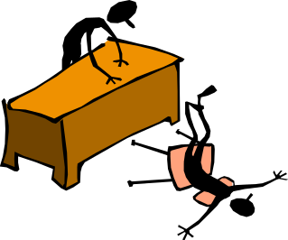

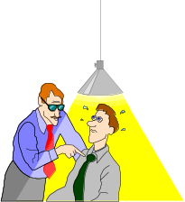
1
3
2
Interest
In job (sends
Resume, etc)
Application
Form
Initial-screen
4
5
6
Goes thru
Selection
“Test(s)”
Background
Investigation
Final
Interview
8
7
9
Medical/
Drug
Testing
Conditional
Job Offer
Placed in Job

Slide 21
Interviews are most valuable for assessing an applicant’s applied mental skills, level of conscientiousness, and interpersonal skills.
To assess applicant-organization fit

Slide 22
Common Interviewing Mistakes

Slide 23
Snap Judgment
Negative emphasis
Not knowing the job
Pressure to hire
Candidate-order error
Nonverbal behavior

Slide 24

Interviews are Biased

Slide 25
Impression management
Interviewers have bad, inaccurate memories
When are decisions made??? First few minutes
SO…..

Slide 26
Influencing an Interview

Slide 27
Prior knowledge
Stereotype
Order of interviews is important
Order of information presented is important
Negatives get high weight

Slide 28
Socialization

Slide 29
The Staffing/Training Balancing Act
Recruitment,
Selection,
and
Placement
Training
and
Development
Fitting New
Employee and
Job Together
Making Sure
That Employees
Grow with Their Jobs

Slide 30

Training

Slide 31

Learning Principles

Slide 32
Participation
Repetition
Relevance
Transference
Feedback

Slide 33
Types of Training
Basic Literacy Skills
Technical Skills
Interpersonal Skills
Problem-Solving Skills

Slide 34

Let’s stop it here

Slide 35

Enough for today. . .

Slide 36
Summary

Slide 37
Job Analysis Outcomes
  Job description
  Job specification
  Job evaluation

Slide 38
Selection
Will I get a job?

Slide 39
Common Interviewing Mistakes

Slide 40
Socialization

Slide 41
Training

Slide 42
Next….

Slide 43
Organizational Behavior
(MGT-502)
Lecture-34

